Slide 1

Understanding Network Reconnaissance
Network reconnaissance is gathering detailed information about a target network to identify potential vulnerabilities and attack surfaces
Map open ports and services
Identify OS and device types
Detect firewall and IDS presence
Prioritize targets for further testing

Slide 2
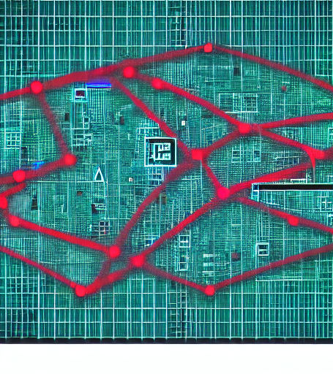
Basics of Port Scanning
Port scanning identifies open closed and filtered ports on a host revealing services and potential vulnerabilities
Rapid packet probes reveal service state
Timing adjustments balance speed and stealth
SYN ACK and UDP scans differ in behavior
IDS signatures flag common scanning patterns

Slide 3
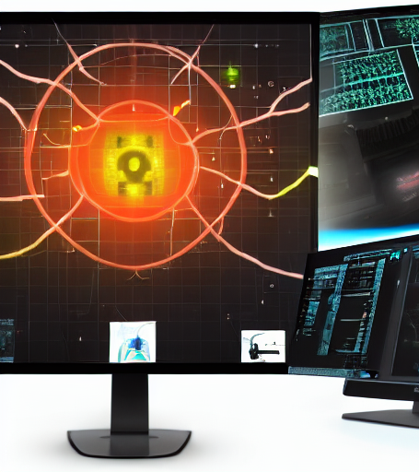
Reconnaissance Goals and Objectives
Network reconnaissance systematically gathers data about target networks mapping devices services and potential vulnerabilities
Identify IP ranges and host availability
Enumerate open ports and running services
Detect system operating systems and software versions
Assess potential entry points and vulnerabilities

Slide 4

Information Gathering Techniques
Information gathering collects target network data to identify assets
Passive techniques sniffing traffic analyzing DNS queries
Active probing port scanning banner grabbing
OS fingerprinting Nmap p0f for OS detection
Service enumeration HTTP headers SSH key exchanges

Slide 5

Passive versus Active Reconnaissance
Passive reconnaissance gathers information without contacting the target while active reconnaissance probes the target directly
Passive intercepts public data eg DNS WHOIS
Active sends probes eg ping SYN scan
Passive leaves no footprints active creates logs
Passive slower lower detection active faster higher risk

Slide 6

Scanning Methods Overview
Scanning methods systematically probe network hosts to discover open ports and services aiding threat assessment
TCP Connect establishes full TCP handshake reliable data exchange
SYN Stealth sends half-open SYN checks responses low footprint
UDP Scan broadcasts UDP packets infers open services via error
ACK Scan identifies firewall rules by ACK responses

Slide 7
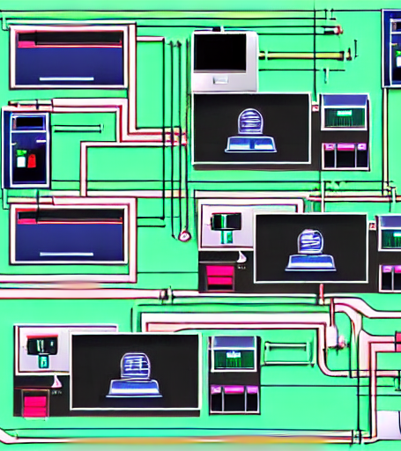
TCP Connect Scan Explained
A TCP connect scan initiates a full TCP handshake to discover which ports are open on a target host
Sends SYN waits for SYNACK then ACK
Closed ports reply with RST
Open ports confirm via successful handshake
Traffic is obvious easy for IDS detection

Slide 8

UDP Scan Fundamentals
UDP scan probes ports without handshake indicating open services
Stateless probes make detection of open ports harder
Timeouts increase scan duration and traffic noise
ICMP unreachable replies confirm closed or filtered ports
Tools like Nmap use payload patterns for service detection

Slide 9

SYN Scan for Stealth
A SYN scan initiates halfopen TCP connections to detect open ports It sends SYN packets but never completes the handshake reducing detection risk
Sends SYN no ACK halfopen connection
SYNACK response indicates port open
RST means closed no reply hidden
Minimal TCPIP footprint evades basic IDS

Slide 10

Fragmentation and Evading Detection
Fragmentation splits a packet into smaller pieces to evade IDSIPS detection
Split packets to hide malicious payloads
Reassembly by target network masks traffic patterns
IDS often inspect only initial fragments
Use overlapping fragments to confuse detection

Slide 11

Scan Timing and Performance
Scan timing controls when and how quickly port scans run balancing speed with stealth
Choose scan type syn ack null
Set delay between packets
Monitor target response time
Adjust rate based on firewall detection

Slide 12
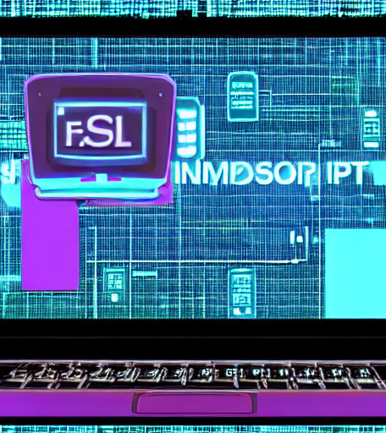
Using Nmap for Port Discovery
Nmap scans hosts to identify open ports and running services It uses packet crafting to probe network devices efficiently
Use -sS for stealth SYN port scanning
Scan all ports with -p- for exhaustive discovery
Add -O flag for operating system fingerprinting
Export findings with -oA to HTML XML grepable

Slide 13

Advanced Nmap Scripting
Leverage NSE to automate indepth discovery exploitation and reporting
Use NSE to extend Nmaps probing capabilities
Automate OS detection version scanning and vulnerability checks
Integrate external script databases and custom scripts
Run quick defaults with -sC and --script options

Slide 14
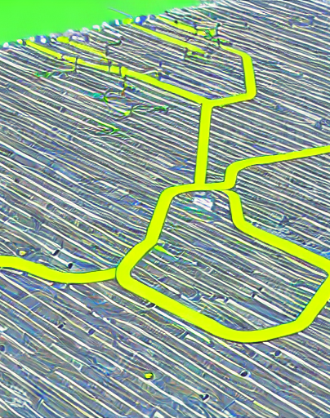
Network Topology and Scanning
Network topology defines how devices and links are arranged scanning reveals exposed interfaces and services
Identify physical and logical device connections
Map IP address ranges to network segments
Detect open ports on each host
Visualize topology with colorcoded device status

Slide 15

Firewall Interaction and Bypass
A firewall filters inbound and outbound traffic between networks often blocking unauthorized access Attackers probe identify weaknesses and use stealth or protocol exploits to bypass these controls
Identify firewall rules via port scans
Use stealthy lowvolume traffic
Exploit protocol quirks or misconfigurations
Deploy tunnel or proxy techniques

Slide 16

Detection Techniques for Network Defenders
Detection techniques enable defenders to spot reconnaissance and port scanning early mitigating potential breaches
Signature-based IDS alerts on known scan patterns
Anomaly detection flags unusual traffic bursts
Honeypot traps reveal malicious probes
Flow analytics monitors port activity trends

Slide 17

Countermeasure Strategies
Countermeasure strategies are proactive and reactive techniques designed to detect mitigate and prevent unauthorized network reconnaissance and port scanning attempts
Deploy IDS/IPS to detect scanning patterns
Implement rate limiting and throttling on open ports
Use honeypot decoy systems to lure attackers
Enforce strict firewall rules and segmentation

Slide 18
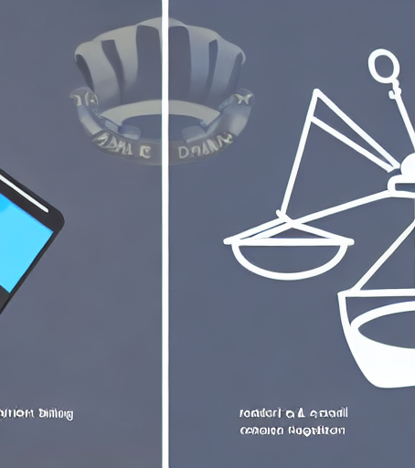
Legal and Ethical Considerations
Network reconnaissance and port scanning are legal only with explicit authorization Unauthorized scanning can breach privacy and be illegal
Obtain explicit permission before scanning
Follow applicable data protection laws
Document all scanning activities
Avoid disrupting production services

Slide 19

Future Trends in Network Reconnaissance
Emerging techniques and tools that enable faster stealthier and more automated mapping and exploitation of network topologies
AIdriven threat intelligence accelerates target profiling
Homomorphic encryption preserves privacy in passive scans
Quantumresistant protocols reshape portscanning feasibility
EdgeAI devices perform realtime reconnaissance

